Slide 1
Principles of multimedia
Week 3
Information content

Slide 2
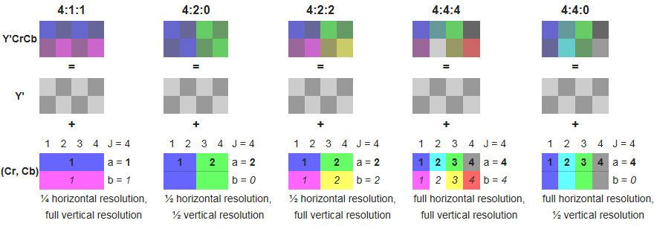
Downsampling

Slide 3
Downsampling
4:4:4 YUV (YCbCr) - conventional format, no downsampling, Y, U(Cb), V(Cr) components are sampled at every pixel. If each component takes 8 bits, than every pixel requires 24 bits. This format is often denoted as YUV (YCbCr) with the 4:4:4 descriptor omitted.
4:2:2 YUV (YCbCr) - uses the 2:1 horizontal downsampling. It means that the Y component is sampled at each pixel, while U(Cb) and V(Cr) components are sampled every 2 pixels in horizontal direction. If each component takes 8 bits, the pair of pixels requires 32 bits.
4:1:1 YCbCr - uses the 4:1 horizontal downsampling. It means that the Y component is sampled at each pixel, while Cb and Cr components are sampled every 4 pixels horizontally. If each component takes 8 bits, each four horizontal pixels require 48 bits.
4:2:0 YUV (YCbCr) - uses the 2:1 horizontal downsampling and the 2:1 vertical downsampling. Y is sampled at each pixel, U(Cb) and V(Cr) are sampled at every block of 2x2 pixels. If each component takes 8 bits, each four-pixel block requires 48 bits.

Slide 4
Entropy
Entropy is the measure of the average uncertainty of information
or
Entropy is an average information content for the given source symbol
H – entropy
P – probability
X – random variable with a discrete set of possible outcomes
(X₀, X₁, X₂, … X_{n-1}) where n is the total number of possibilities

Slide 5
Entropy: Two examples
Entropy is greatest when the probabilities of the outcomes are equal
Let’s consider our fair coin experiment again
The entropy H = ½ lg 2 + ½ lg 2 = 1
Since each outcome has self-information of 1, the average of 2 outcomes is (1+1)/2 = 1
Consider a biased coin, P(H) = 0.98, P(T) = 0.02
H = 0.98 * lg 1/0.98 + 0.02 * lg 1/0.02 =
= 0.98 * 0.029 + 0.02 * 5.643 = 0.0285 + 0.1129 = 0.1414

Slide 6
Exercises
Implement a function to compute entropy of a color plane and also the image as a whole assuming the distribution of intensities represent the symbol probability of the source.
Implement down sampling if you haven’t done so in an earlier class.
Study, record and submit the variation in compression, entropy and psnr subsequent to the different compression tools you have implemented in this course.

